Slide 1
CSE322
Design of
Turing Machines
Lecture #37

Slide 2
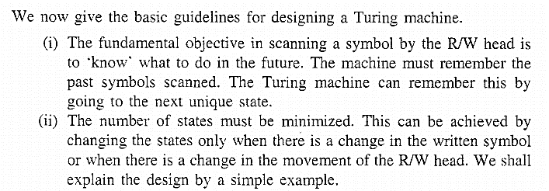
Design of Turing Machine

Slide 3
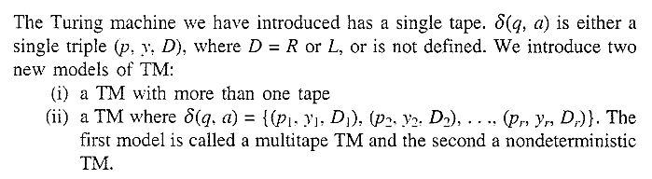
Variants of Turing Machine
Multi Tape Turing Machine
Non Deterministic Turing Machine

Slide 4
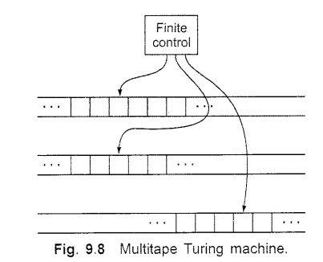

Multi-tape Turing Machine

Slide 5

PROBLEM
Notes:
PROBLEM

Slide 6
